Slide 1

MTA Daily Ridership

Slide 2
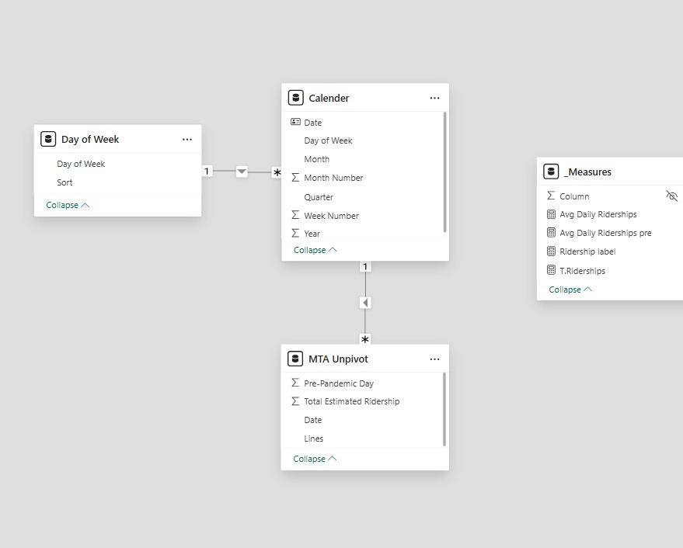
The Metropolitan Transportation Authority (MTA) in New York provides vital public transportation to millions of riders daily. However, understanding fluctuations in ridership due to pandemic and identifying patterns such as rush days can be challenging without clear analysis. This project addresses the problem of understanding and visualizing trends in MTA ridership to support better decision-making for transit planning, operations, and communication with the public. The project collects, cleans, and analyzes MTA turnstile data to reveal meaningful insights about ridership patterns. Using tools like Power BI , the data is processed to Identify peak ridership by years Compare weekday vs. weekend trends Detect anomalies or drops in usage during COVID-19

Slide 3
Problems we face & solutions : 1- The data did not contain pre-rider ships in numbers it was just as percentages, So we calculated it as a columns using m languages in power Query. 2-The structure of the data did not support the visuals we made, So we unpivot tables and it made it easy and readable.

Slide 4
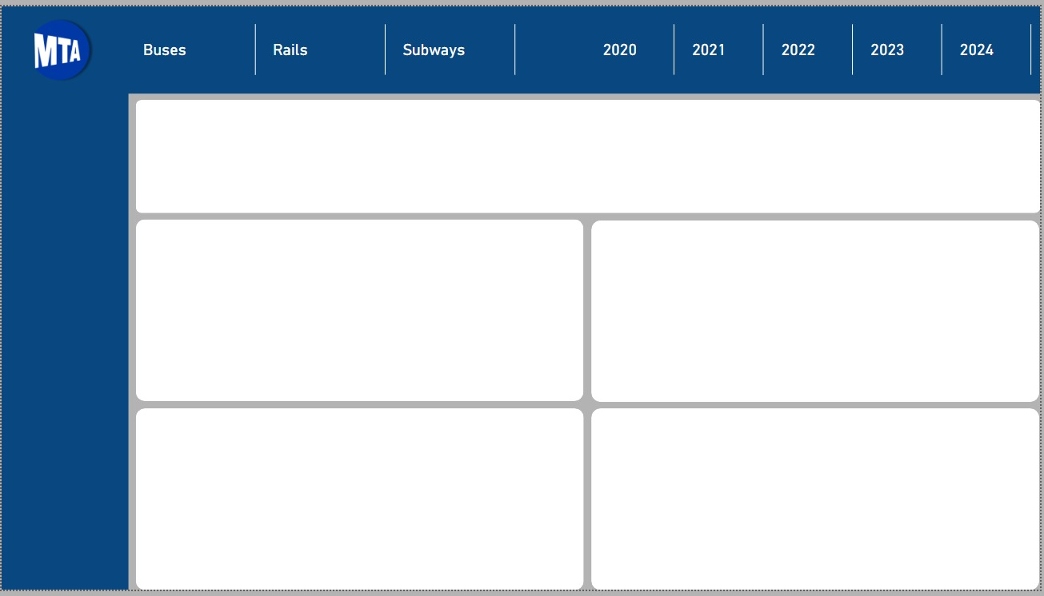
Top Navigation Bar: Transit Type Filters: Users can switch between Buses, Rails, and Subways. Year Filters: Data can be filtered by year from 2020 to 2024 for trend analysis. Main Display Area: The top large section is intended for a key visualization, such as a line graph, map, or KPI summary. The lower grid contains four panels.

Slide 5
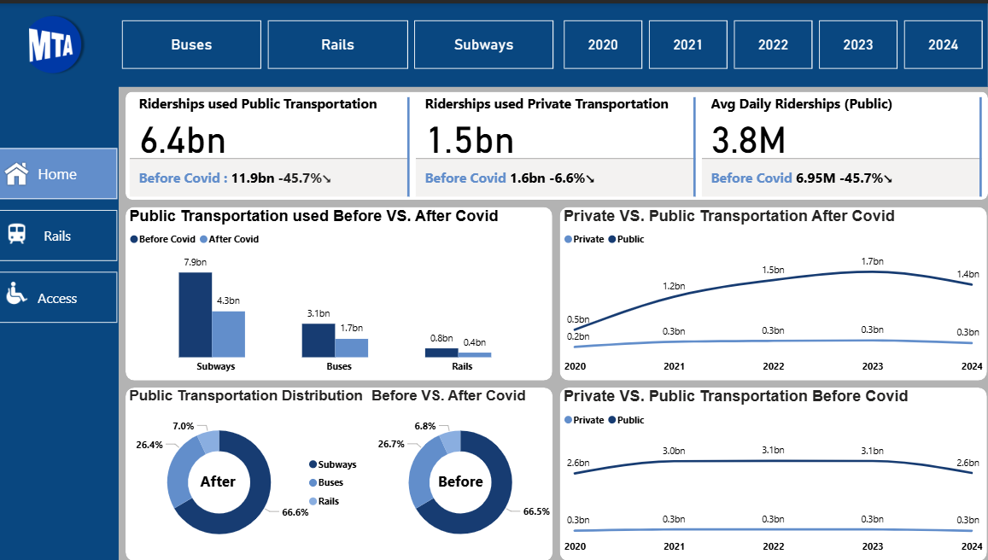
User persons : Transit Planners (Businesses/Government) Key Features Addressing User Needs: Ridership Analytics Dashboard: Visualizes peak hours, station usage, and route popularity. Custom Filters: Allows users to view data by borough, date, or transit line. How These Features Solve Problems it's detect how people react towards the transportation methods after covid to make decision of increase or decrease for example in rails or number of buses easier

Slide 6
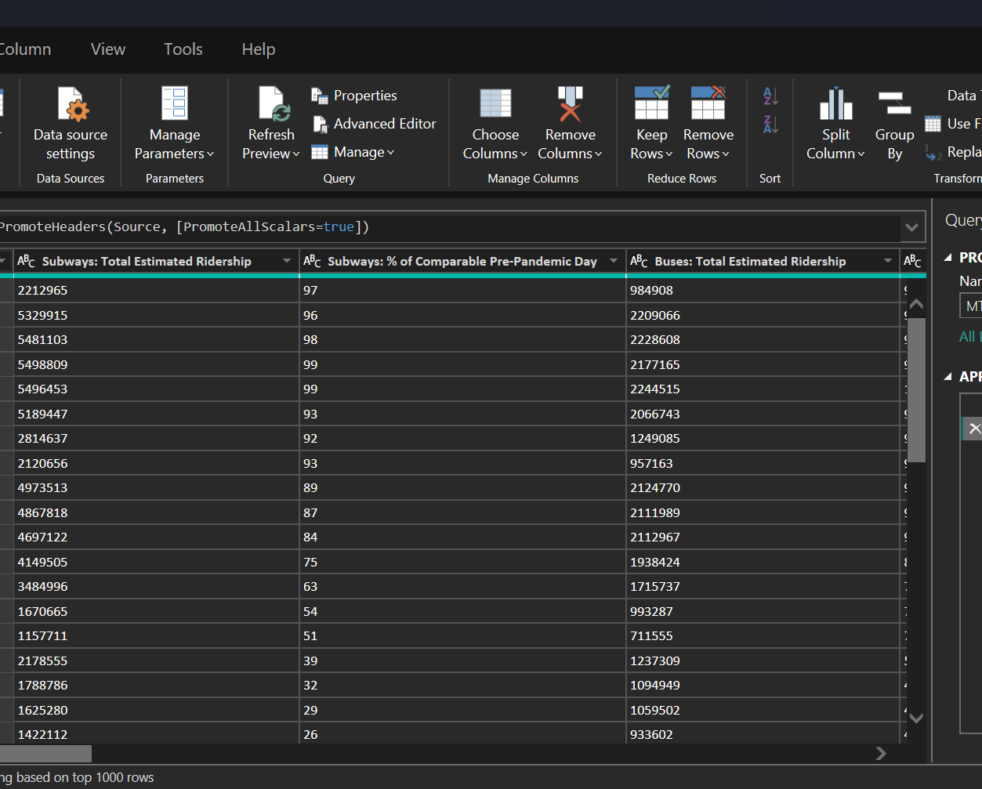
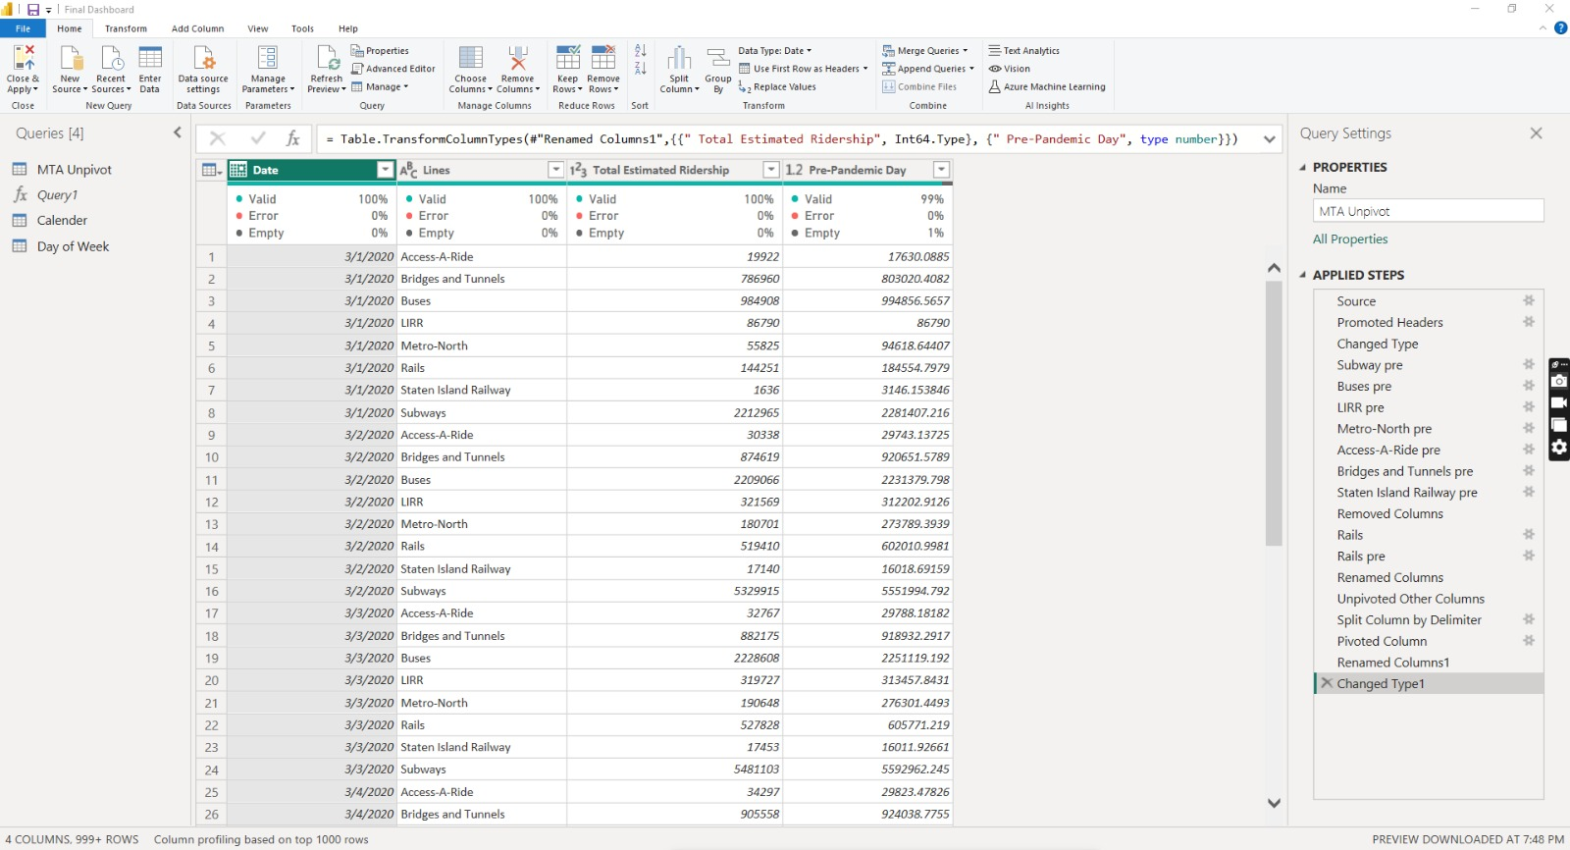
We first made a Callender table after we make sure there is no duplicates .
Then we unpivot the columns then we calculate total ridership pre from the percentages pre columns .
Finally, we made the relationships between columns and make sure the modeling is right.

Slide 7
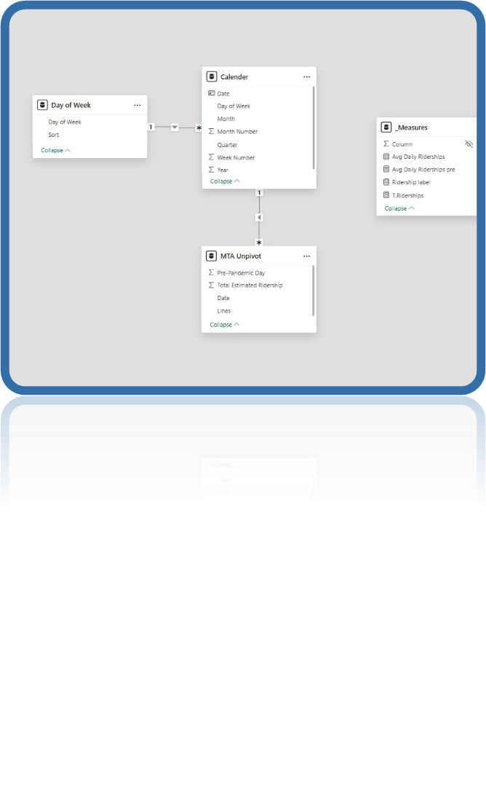
We use only Microsoft Power BI to clean , analyze and visualizing the data .

Slide 8
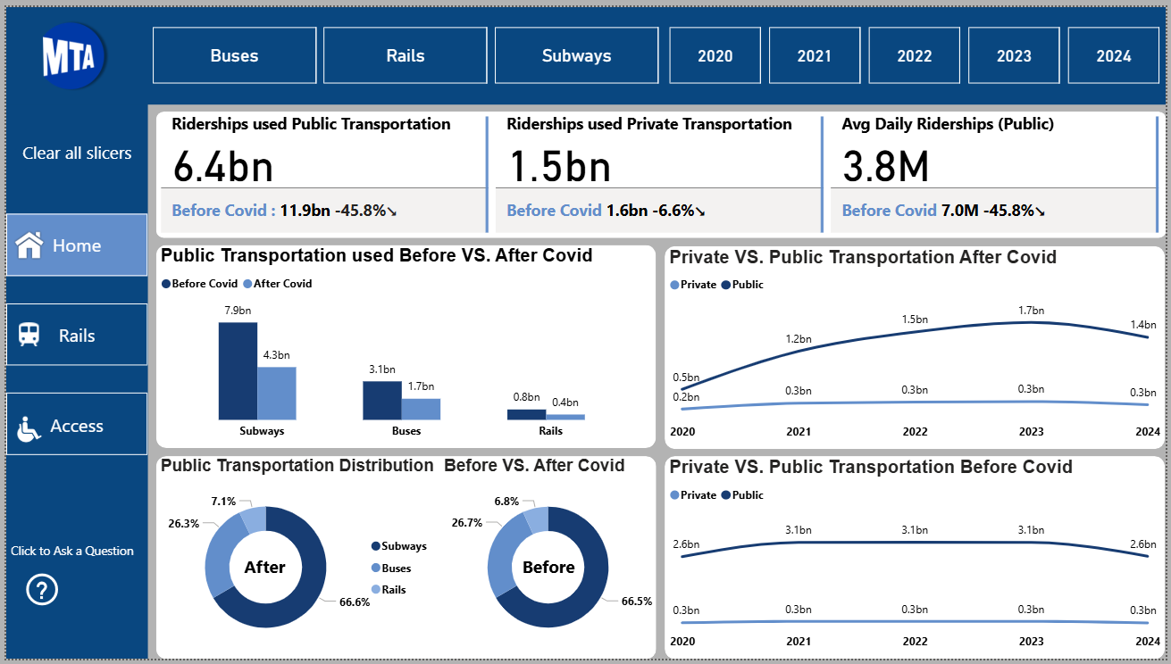
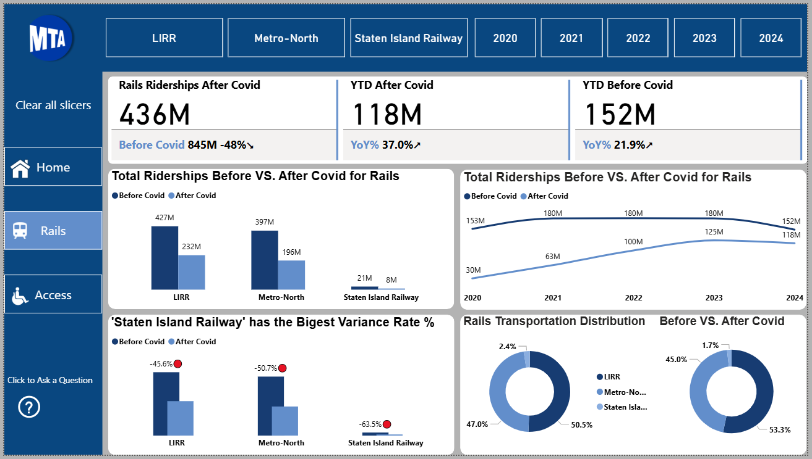
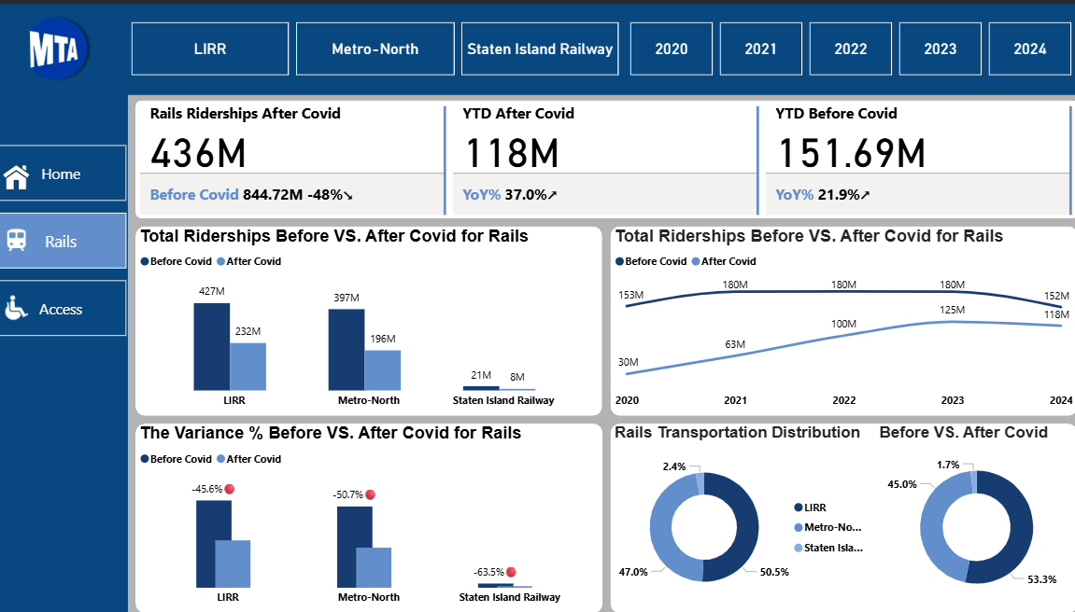
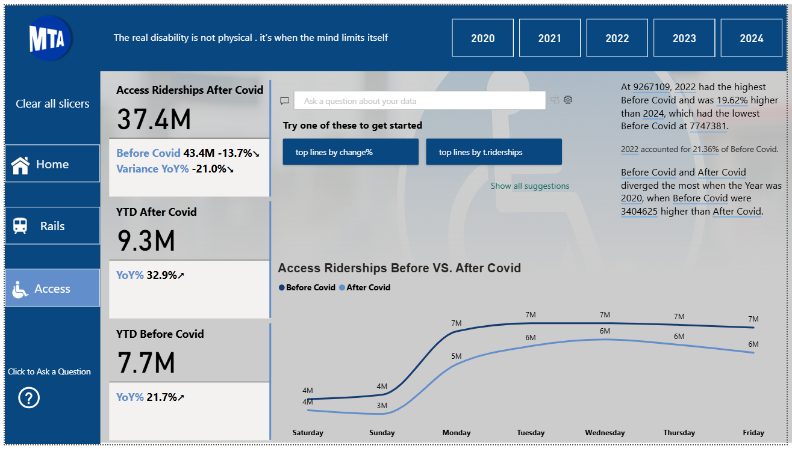
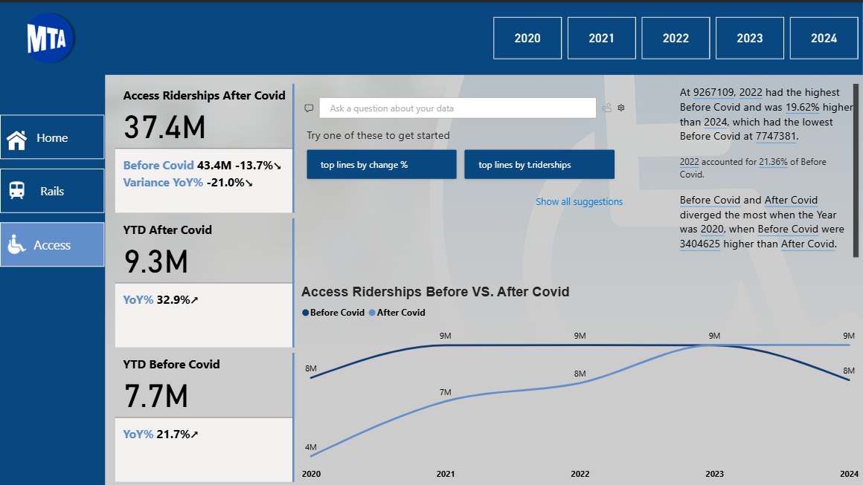

Slide 9
Insights & recommendations : 1-The total number of Rider ships for public transportation decreased by 45.7% from pre-covid, there are 2 probabilities first one is that people used to stay at home especially since work from home is now viral and a lot of people prefer it the second one is that people using their car as the percentage of people using private transportation in decreased only 6.6%. 2- the year 2023 had the highest total ridership for public transportation and then it start decreased in 2024 so there is something make people take a back step from using it or something new has happened. -Courage people to take public transportation by care of the comfort of the seats and how far the car is clean and make ticket price payable and make discounts for people who use it regularly.

Slide 10
Group Members & Roles :
Abdelrahman Saad Abdelmoneem– Project Manager (Coordination, timeline management, data cleaning, data transformation, and validation,Data Visualization)
Yousef Saber Abdel galil – Power BI Developer (Dashboard design and development)&reporting
Nataly Gabra Farouk – Data Visualization Specialist (Ensuring best practices in visualization)
Sara Ahmed Helmy – Quality Assurance (Testing and validation of data and dashboard functionality)

Slide 11
Thank you
Any questions?

